Slide 1
#WOMEN4GROWTH

Slide 2
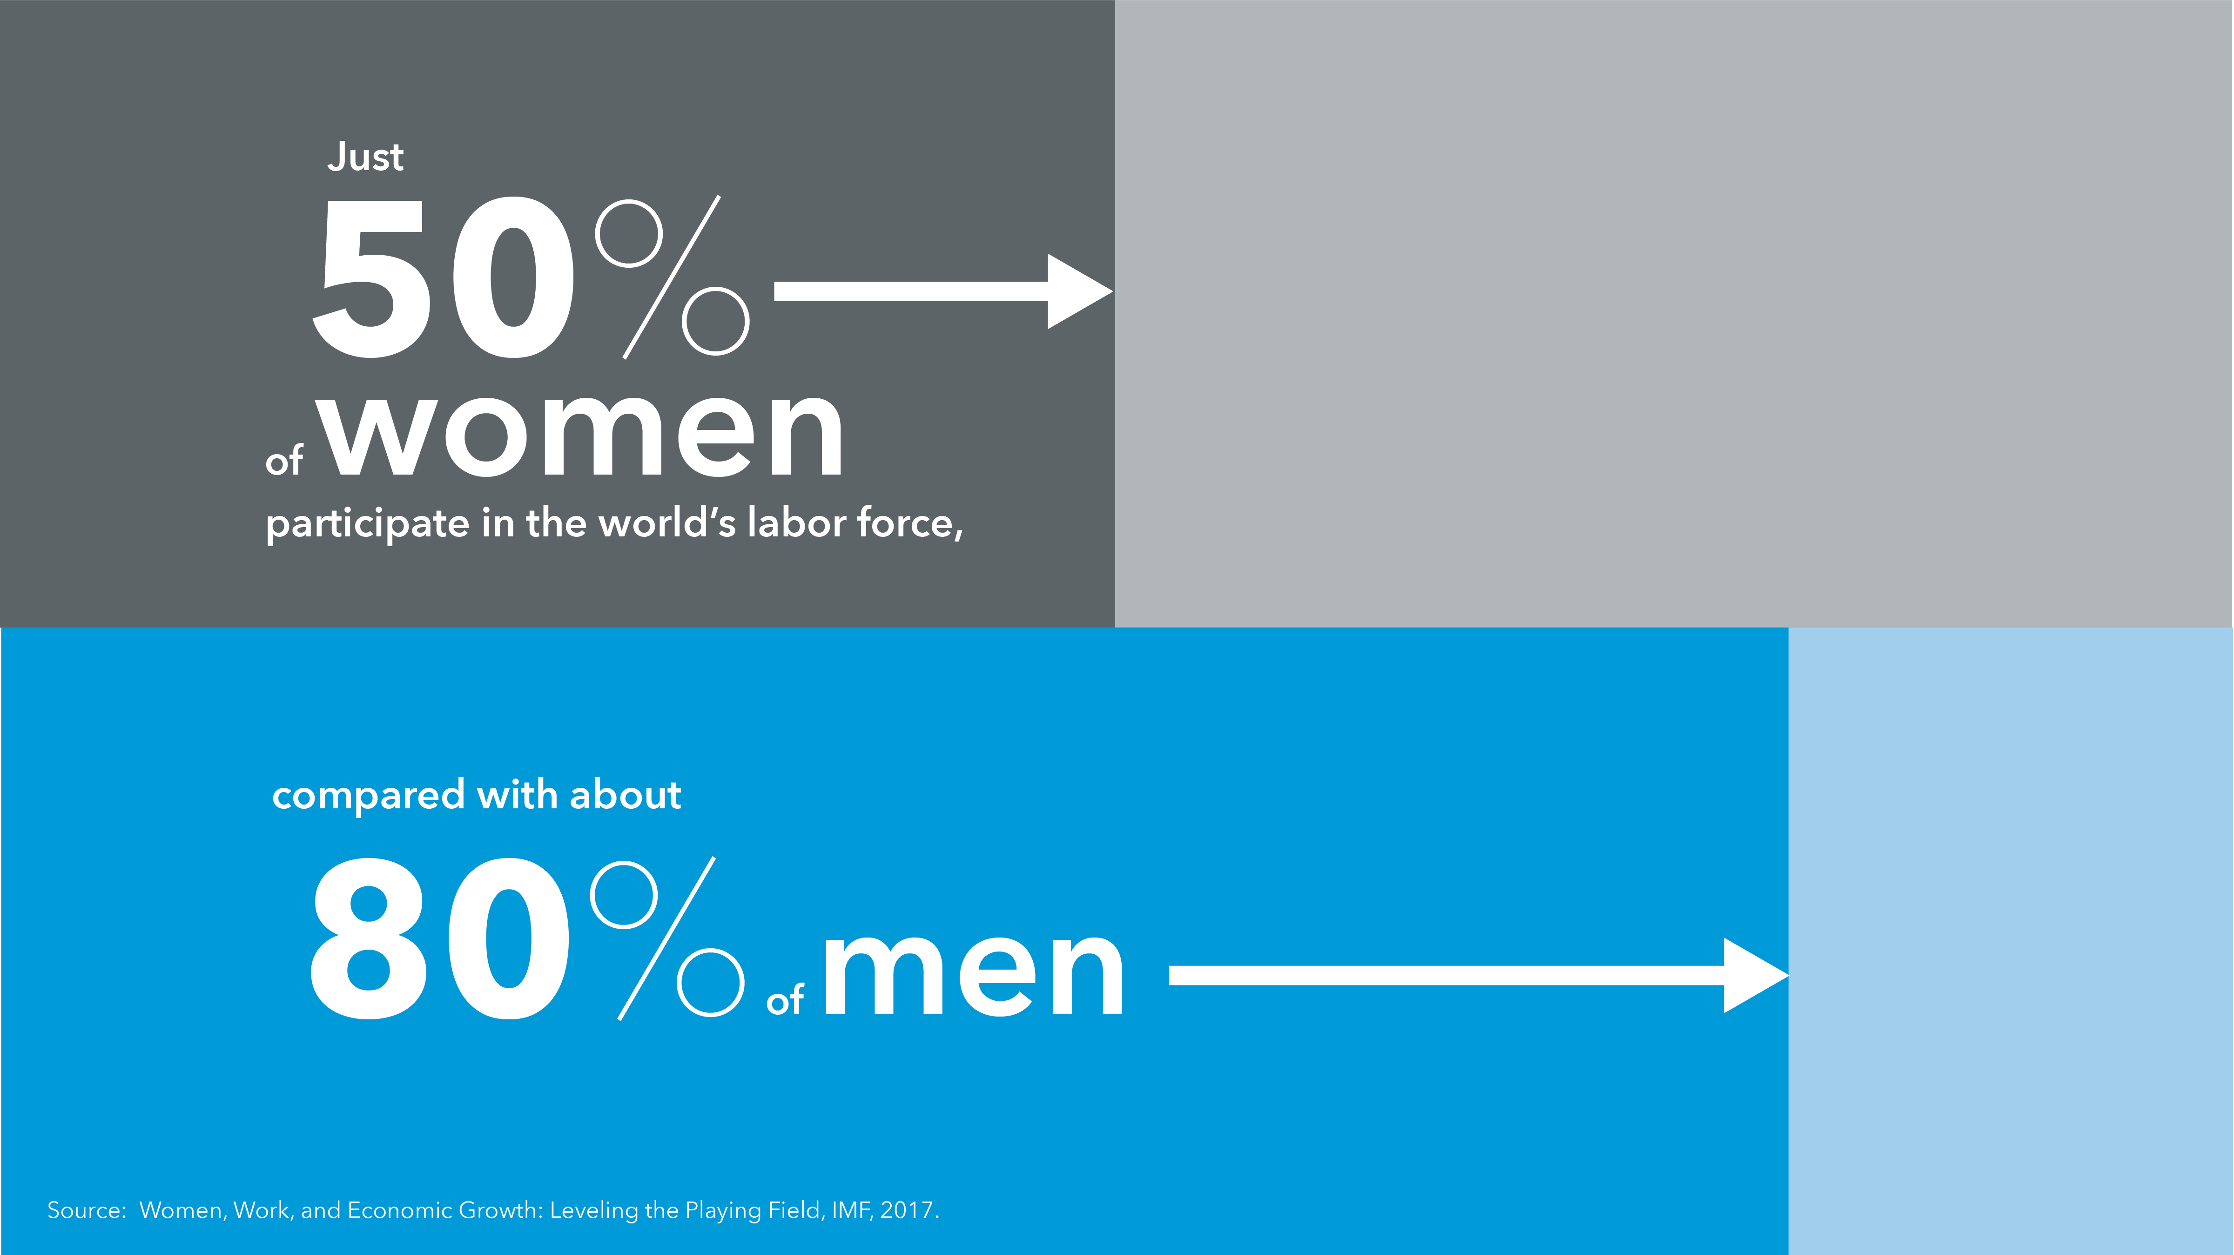
#WOMEN4GROWTH

Slide 3
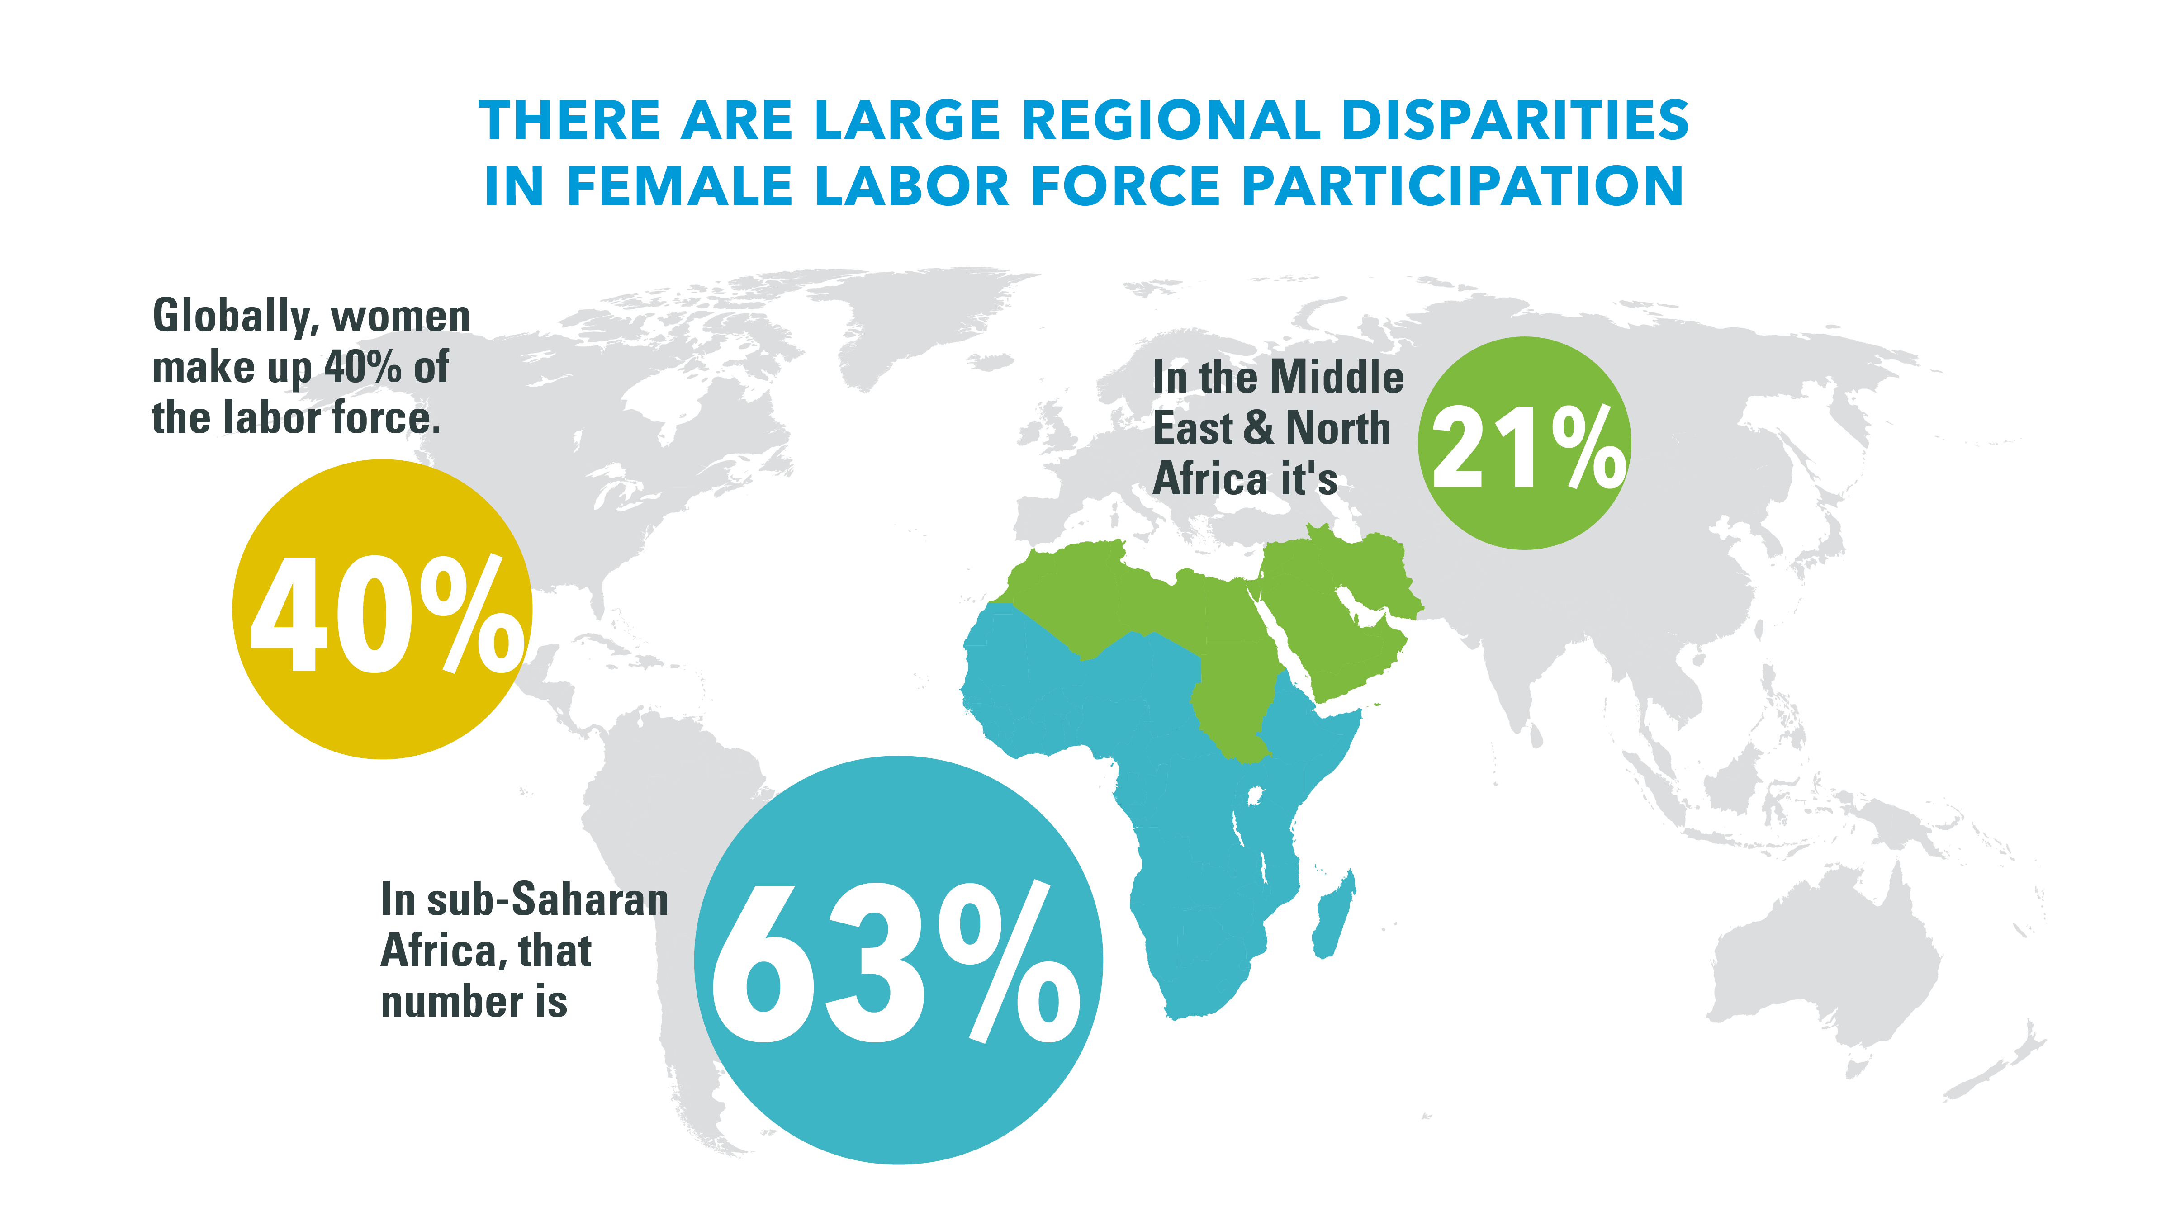
#WOMEN4GROWTH

Slide 4
#WOMEN4GROWTH

Slide 5
#WOMEN4GROWTH

Slide 6
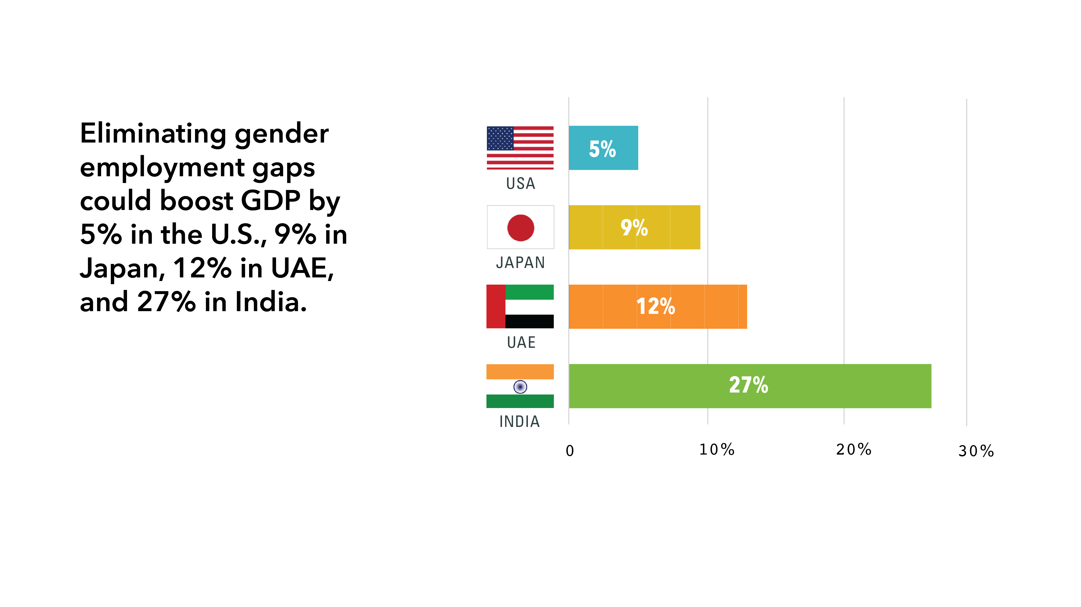
Source: Women, Work, and the Economy: Macroeconomic Gains from Gender Equity, IMF, 2013.
#WOMEN4GROWTH

Slide 7
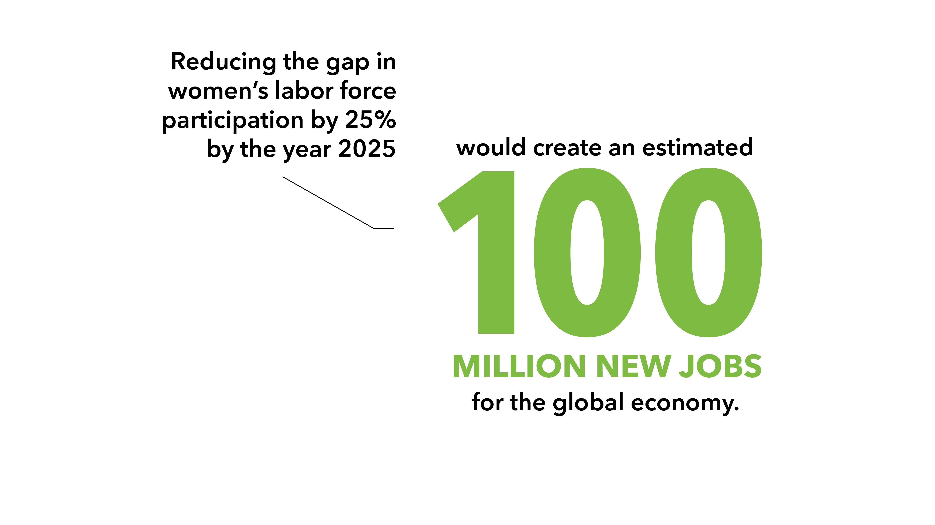
Source: Monitoring progress in reducing the gender gap in labour force participation, OECD and ILO, 2015.
#WOMEN4GROWTH

Slide 8
Source: Global Findex, 2014
#WOMEN4GROWTH

Slide 9
Source: Banking on Women Leaders: A Case for More? IMF, 2017
#WOMEN4GROWTH

Slide 10
#WOMEN4GROWTH
Source: Demystifying the Gender Pay Gap: Evidence from Glassdoor Salary Data, 2016

Slide 11
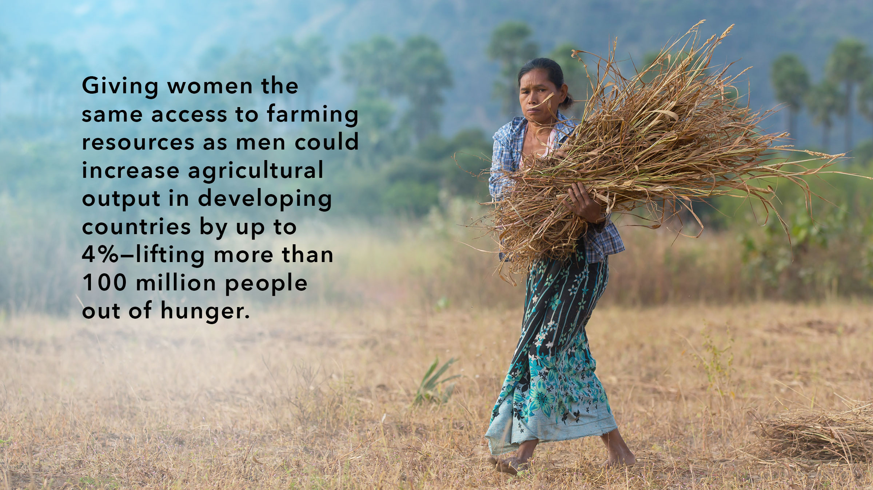
#WOMEN4GROWTH
Source: OECD DAC Network on Gender Equality, Women’s Economic Empowerment

Slide 12
Source: What Works in Girls’ Education: Evidence and Policies from the Developing World. Council on Foreign Relations, New York, 2004.
#WOMEN4GROWTH

Slide 13
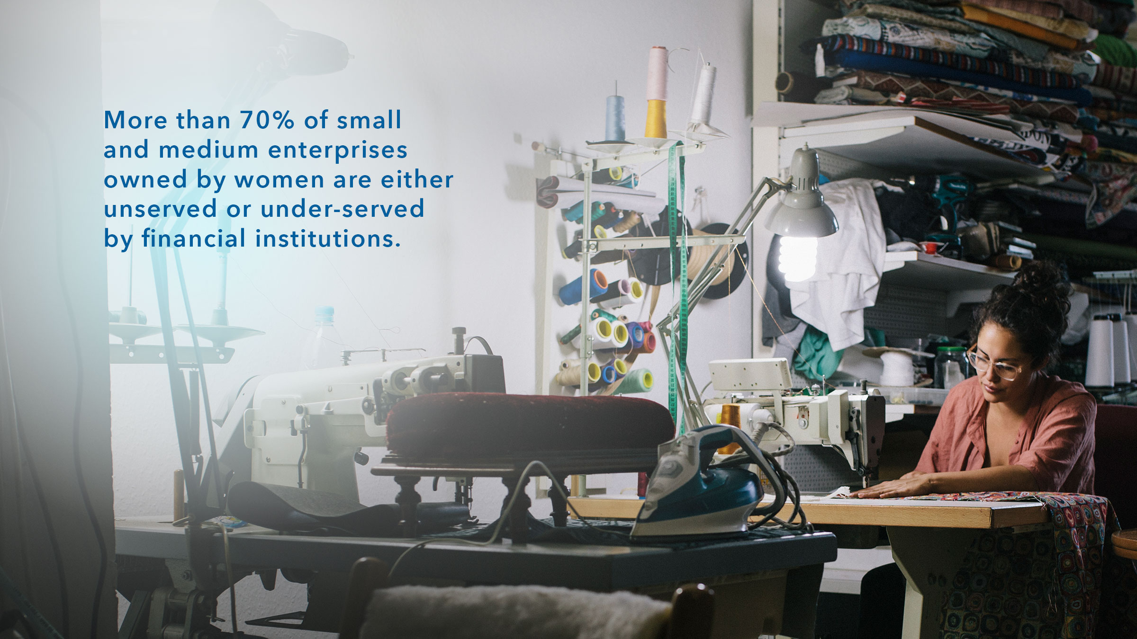
Source: Financial Inclusion—Can it Meet Multiple Macroeconomic Goals? IMF, 2015
#WOMEN4GROWTH

Slide 14
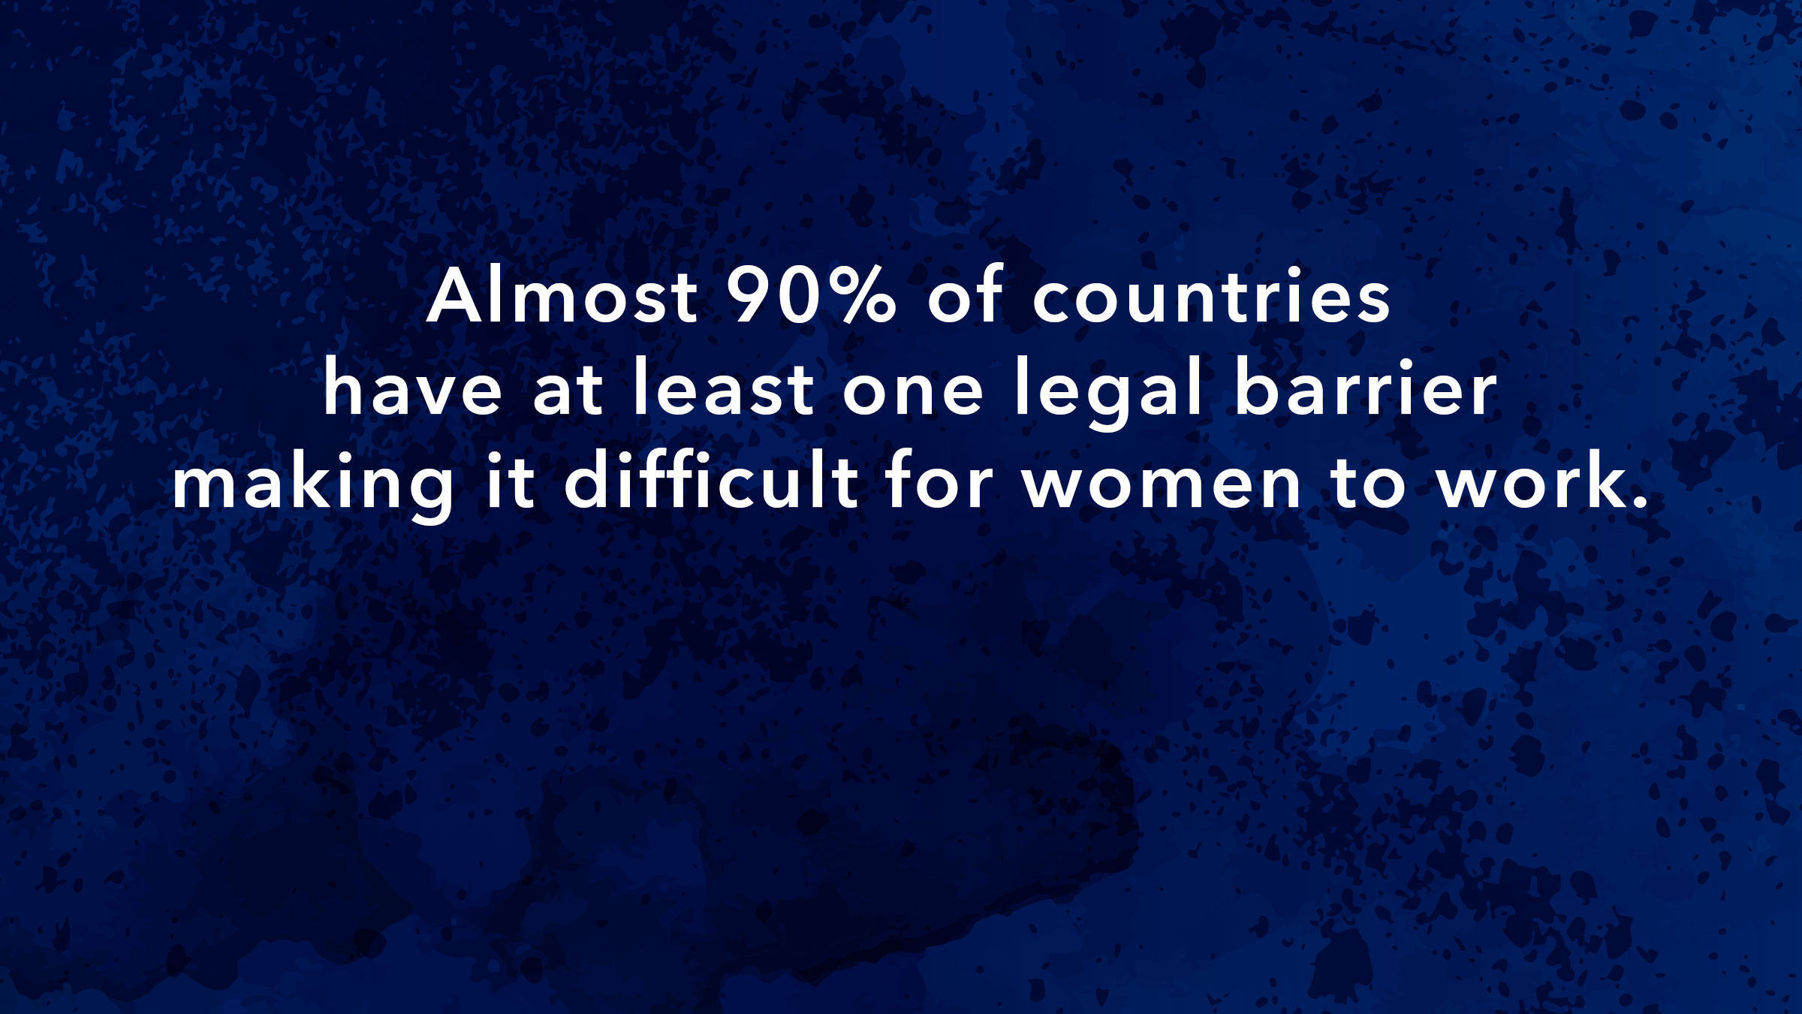
Source: Fair Play: More Equal Laws Boost Female Labor Force Participation, IMF 2015
#WOMEN4GROWTH

Slide 15
#WOMEN4GROWTH
Source: Fair Play: More Equal Laws Boost Female Labor Force Participation, IMF 2015

Slide 16
#WOMEN4GROWTH

Slide 17
Source: Unlocking Female Employment Potential in Europe: Drivers and Benefits, IMF, 2016
#WOMEN4GROWTH

Slide 18
.
#WOMEN4GROWTH

Slide 19
.
Source: World Bank. 2016. Women, Business and the Law 2016: Getting to Equal. World Bank Report, Washington, DC.
#WOMEN4GROWTH

Slide 20
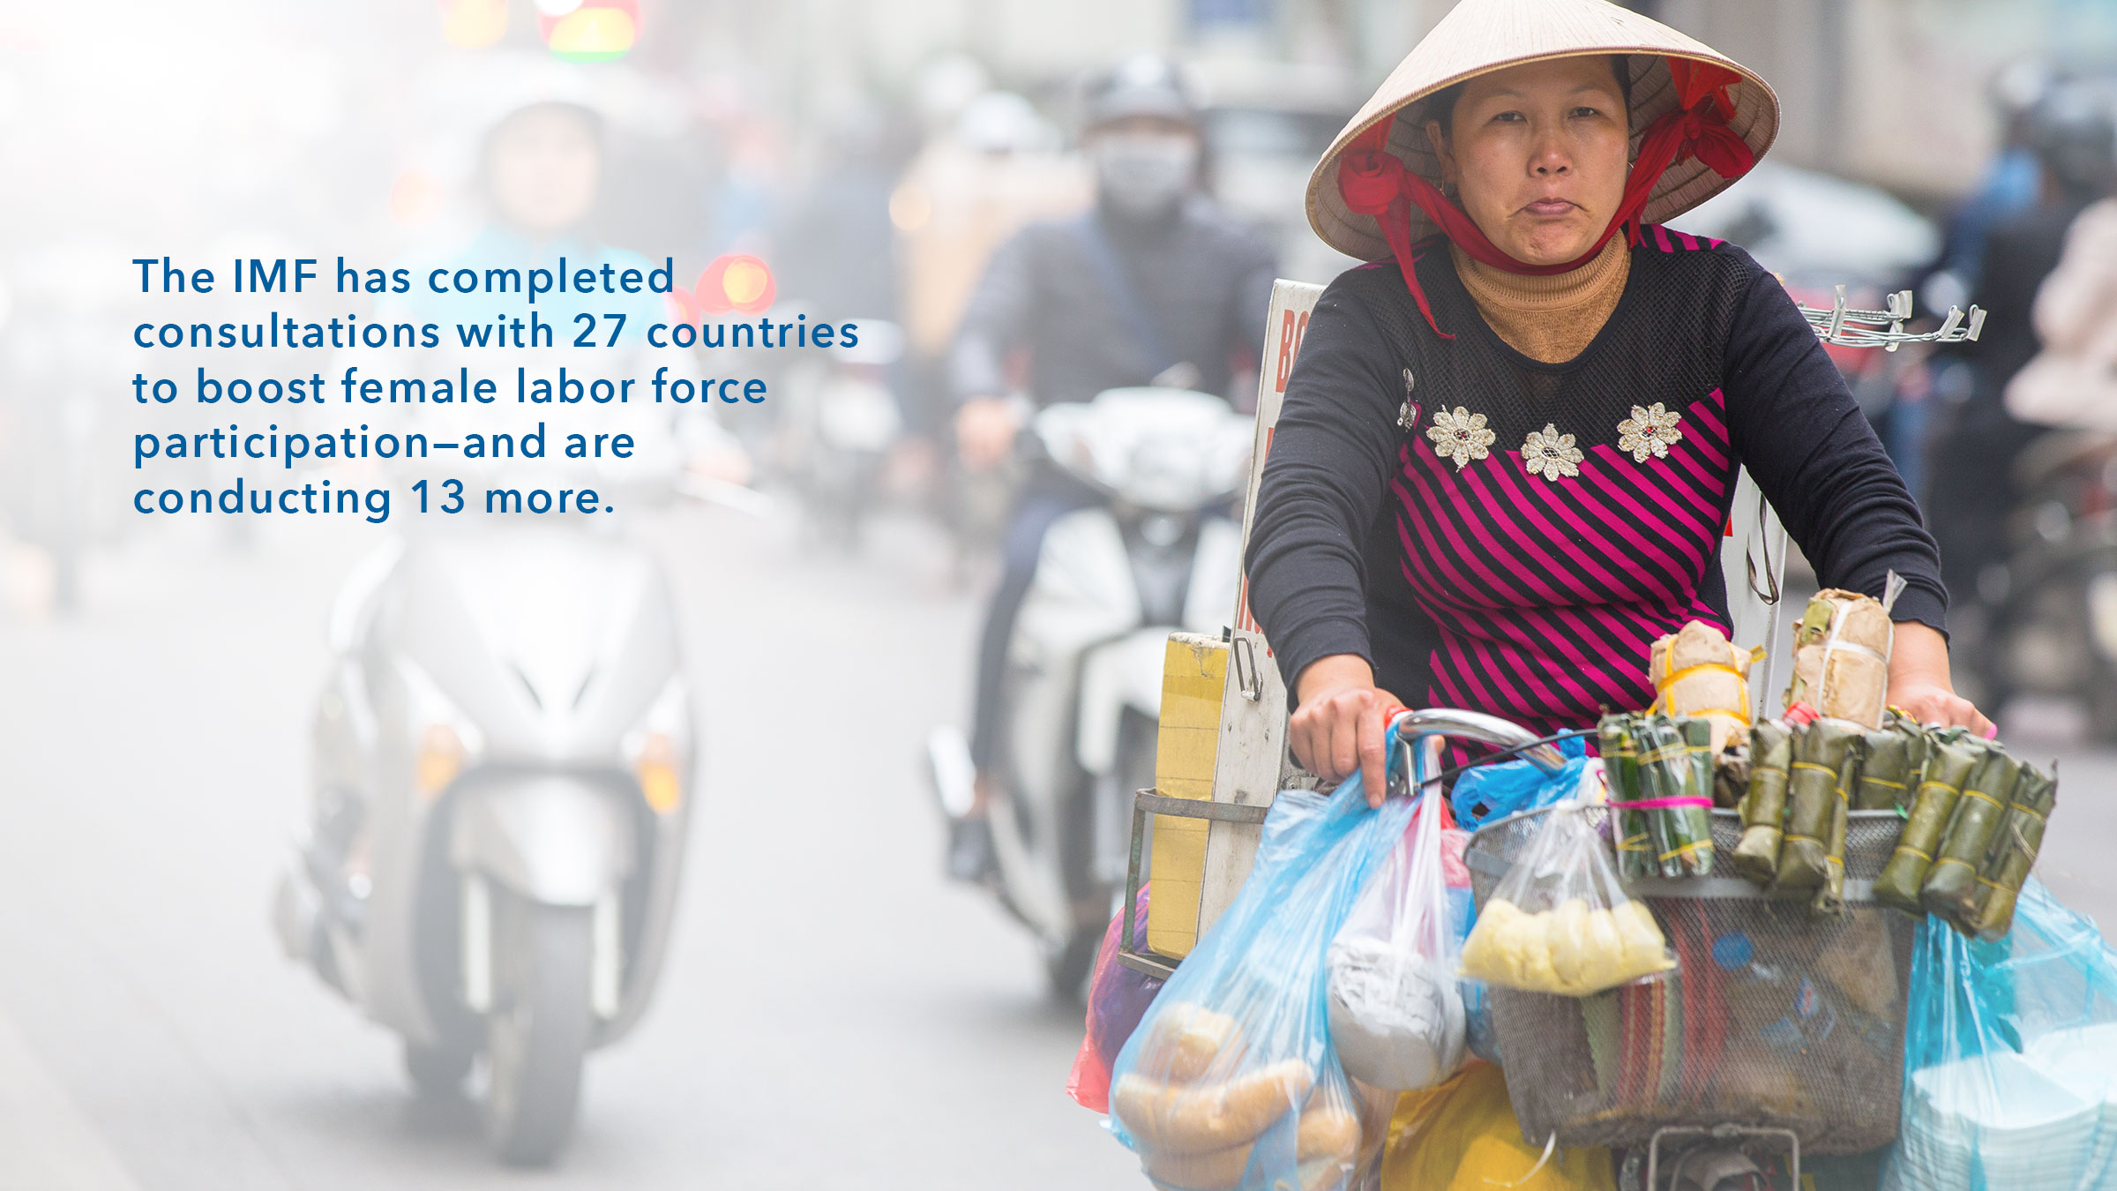
#WOMEN4GROWTH

Slide 21
#WOMEN4GROWTH

Slide 22
#WOMEN4GROWTH

Slide 23
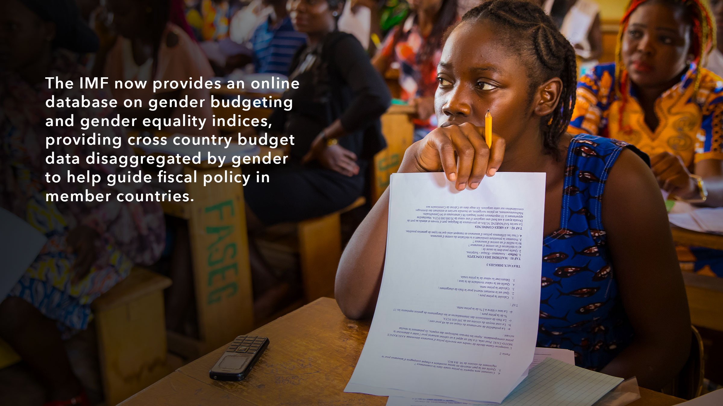
#WOMEN4GROWTH

Slide 24
#WOMEN4GROWTH

Slide 25
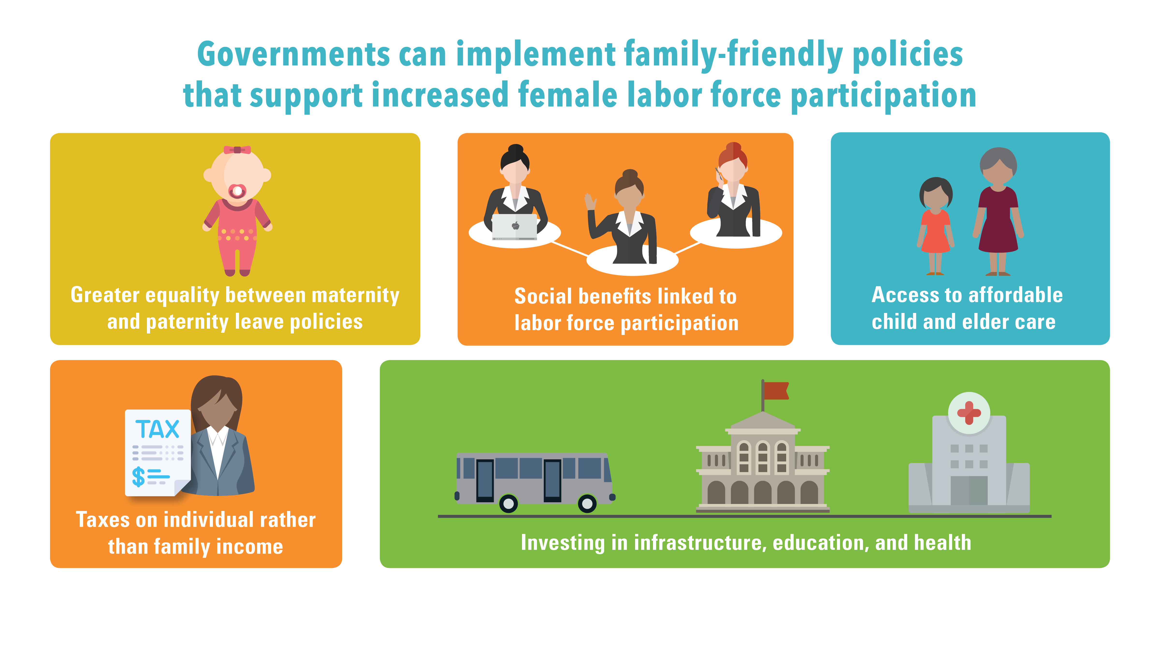
#WOMEN4GROWTH

Slide 26
#WOMEN4GROWTH

Slide 27
#WOMEN4GROWTH

Slide 28
#WOMEN4GROWTH

Slide 29
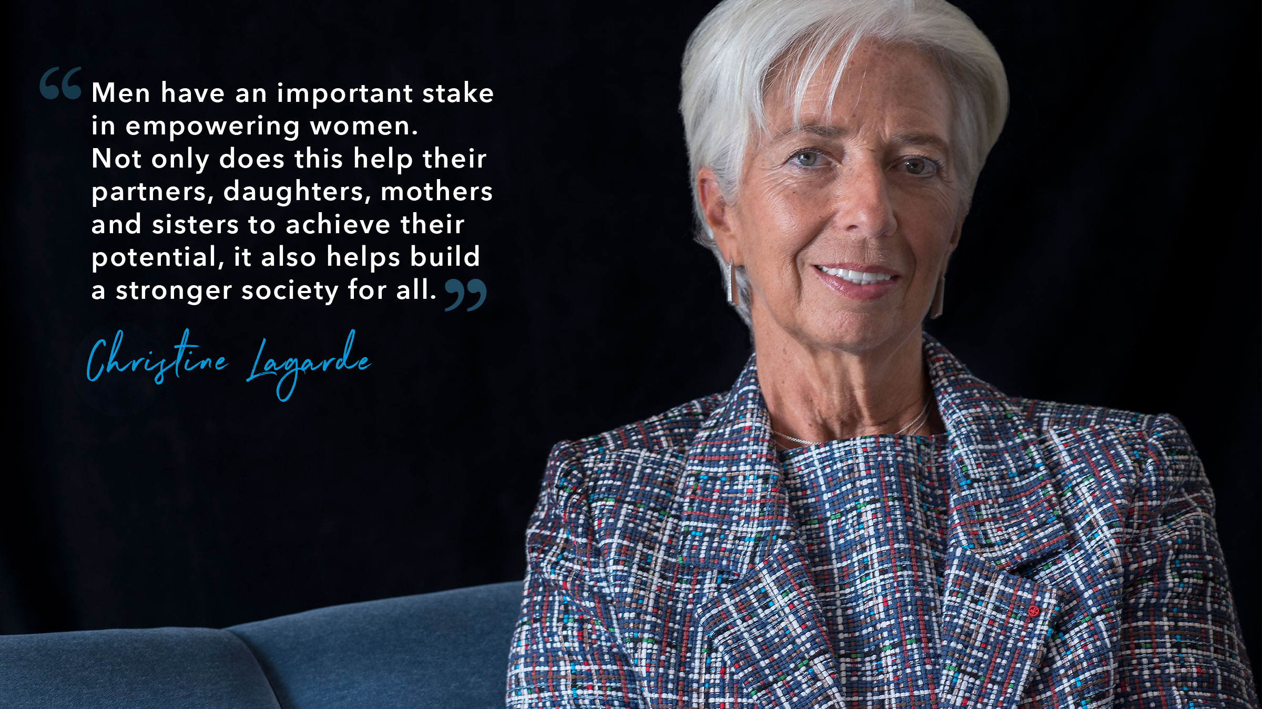
#WOMEN4GROWTH

Slide 30
#WOMEN4GROWTH

Slide 31
#WOMEN4GROWTH

Slide 32
#WOMEN4GROWTH

Slide 33
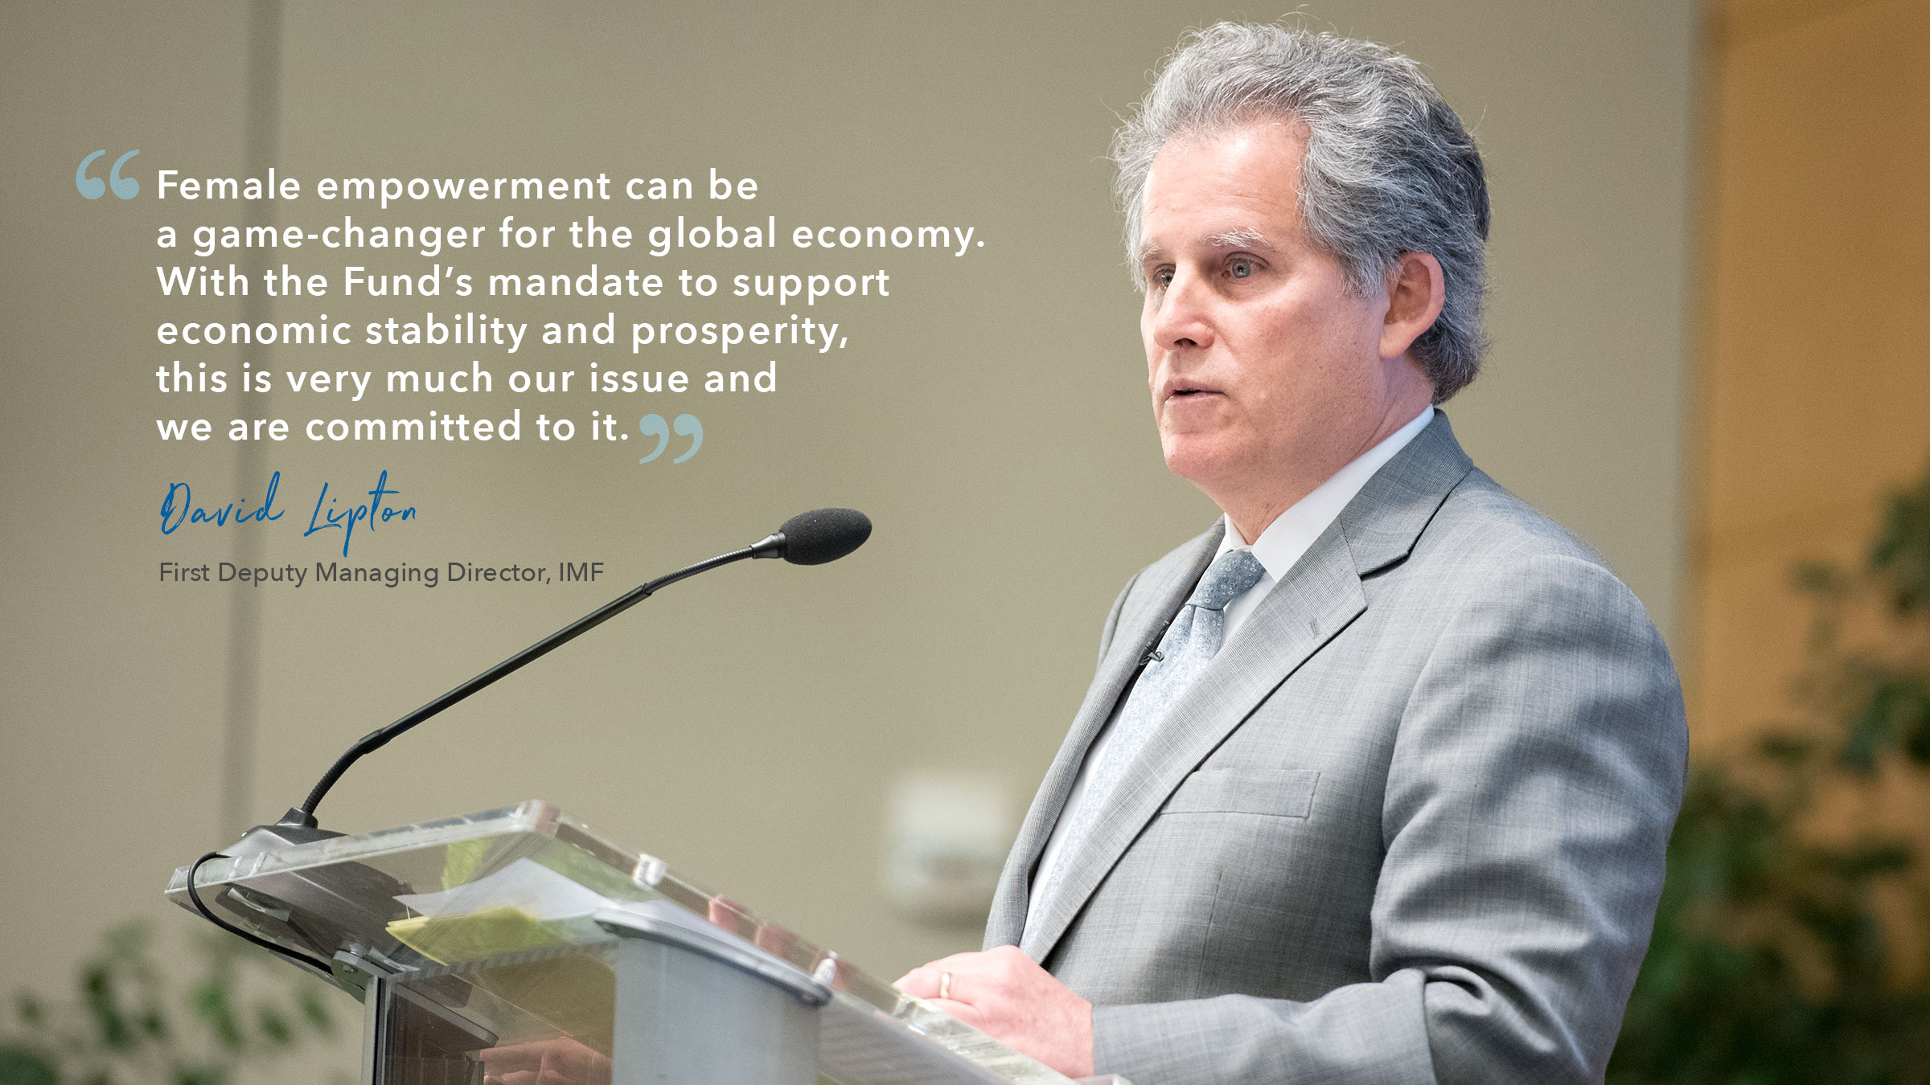
#WOMEN4GROWTH

