Slide 1
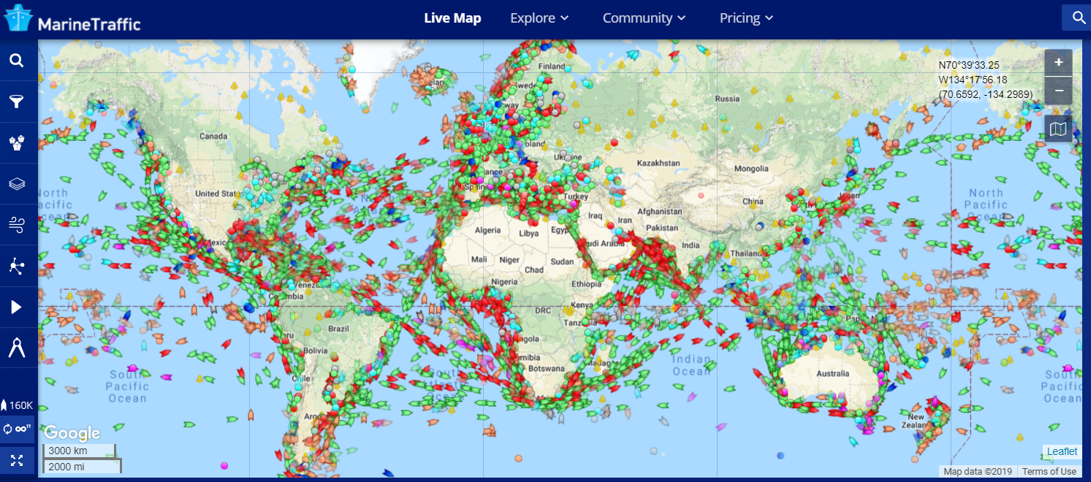
Automatic Identification System (AIS)

Slide 2
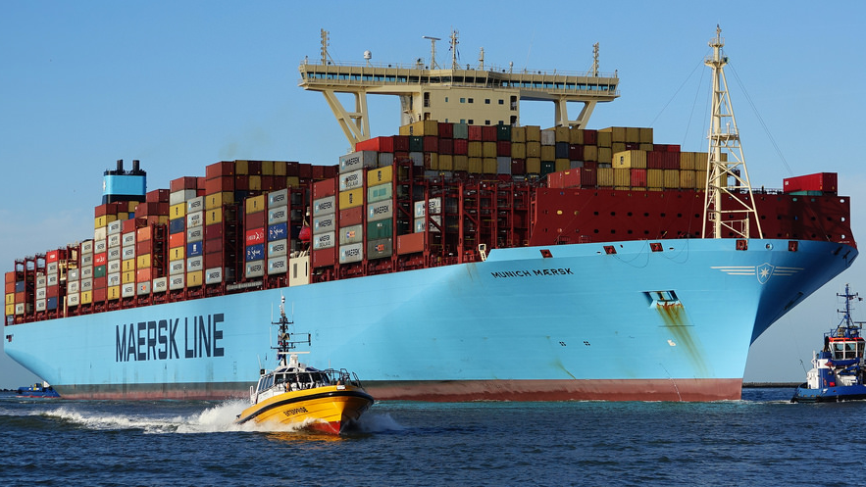
80%
World Trade

Slide 3
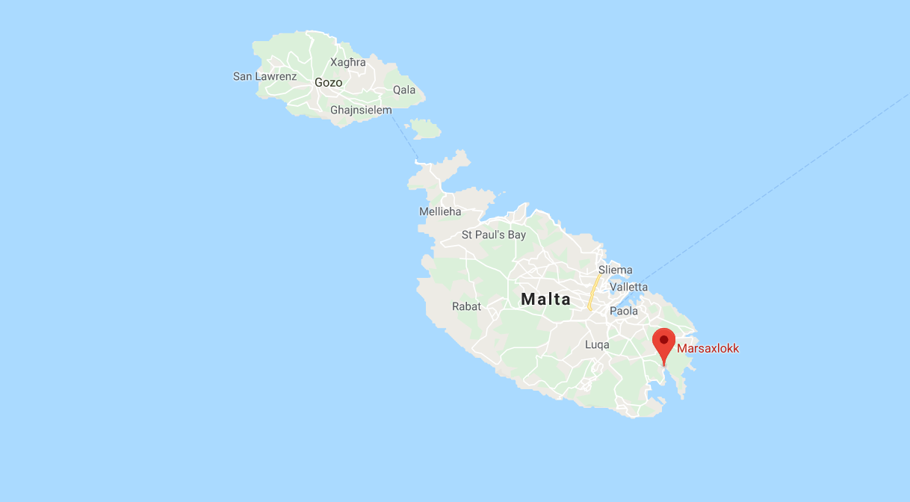

Slide 4
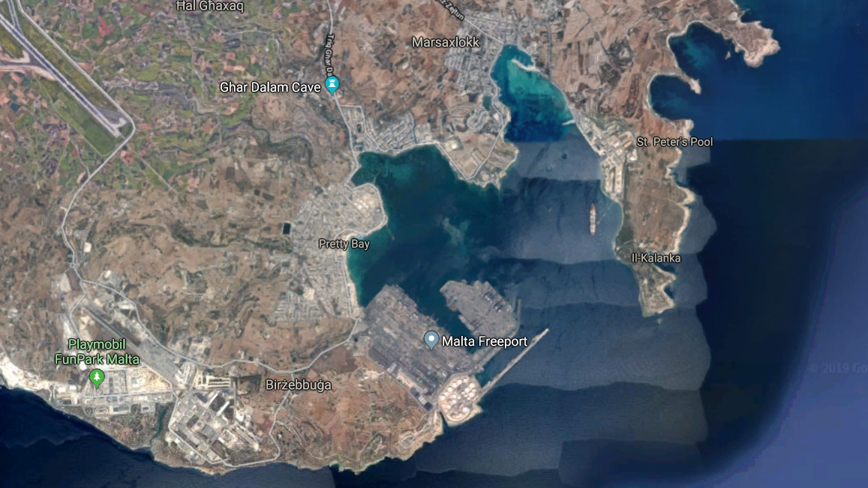

Slide 5
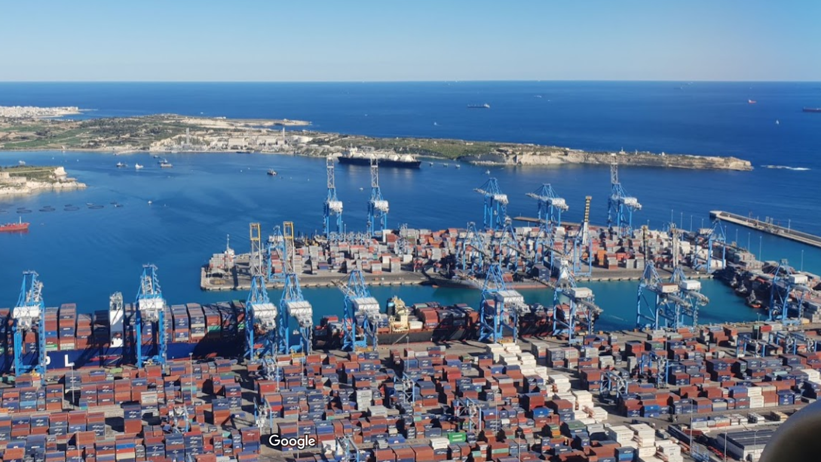

Slide 6
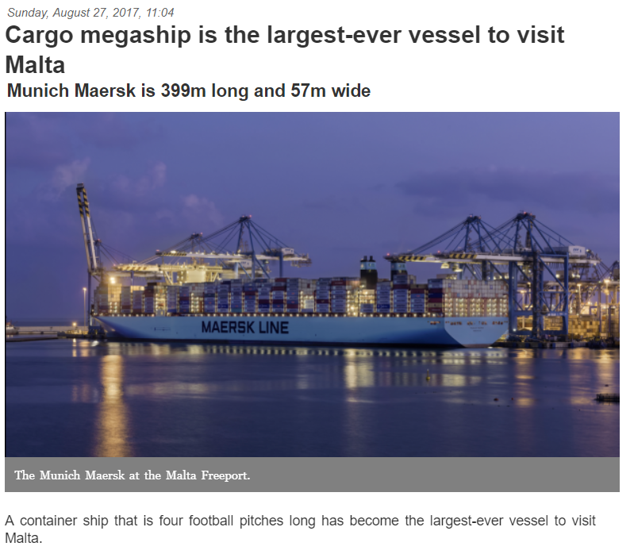

Slide 7
Number of Cargo and Tanker Ships Arrived in Marsaxlokk
2015-2018
Nowcasting
Munich Maersk’s Visit

Slide 8
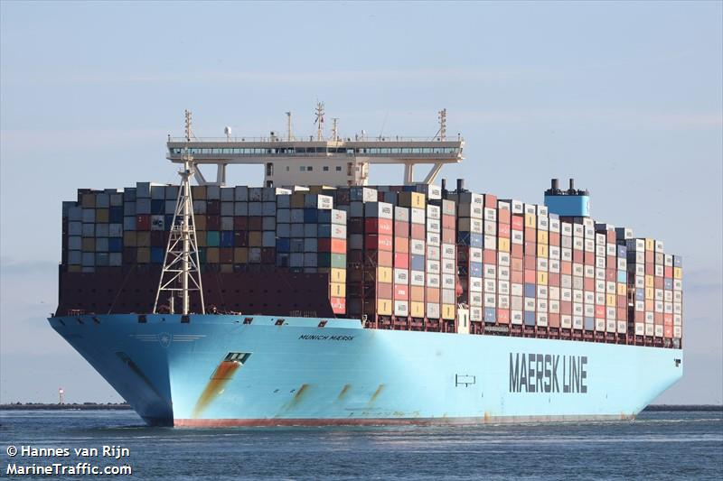
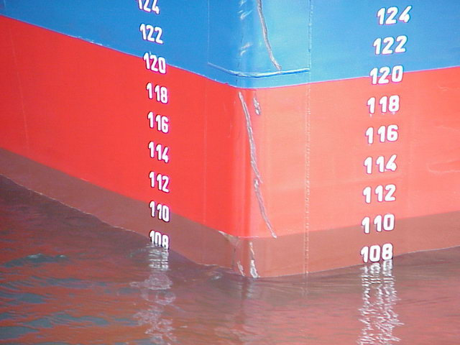
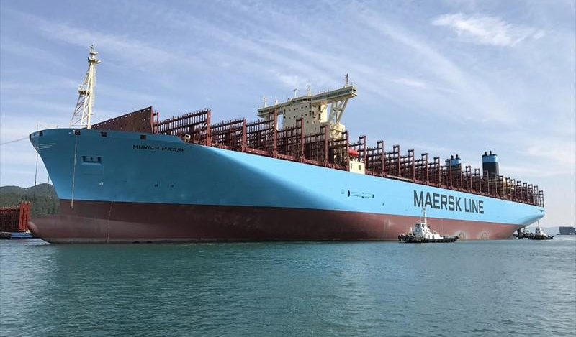
Vertical distance between
the waterline and the bottom of the vessel’s hull
Reported in AIS data
Our key variable to measure trade volumes
Draft

Slide 9
Munich Maersk’s Voyage to Malta Freeport
Aug 17, 2017
2
MUNICH Maersk Arrives MALTA FREEPORT
Draft | 14.8
3
MUNICH Maersk Departs MALTA FREEPORT
Draft | 14.5
Aug 22, 2017
Aug 23, 2017
Aug 25, 2017

Slide 10
Average Timeliness of Trade Statistics in Small States
6 Months
Need for Faster Measurement of Trade Activity

